Slide 1



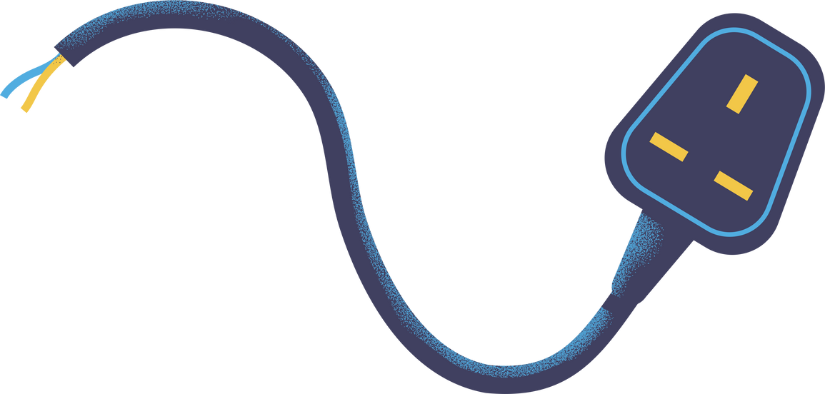

2-bit ALU
Arithmetic Logic Unit

Slide 2
Our Team
Name : Vamja Jeet
Branch : CE
Roll No. : 120
Enroll. No. : 23002170110198
Name : Bhavik Bhimani
Branch : CE
Roll No. : 135
Enroll. No. : 23002170110014
Name : Mohit Ghadiya
Branch : CE
Roll No. : 136
Enroll. No. : 23002170110042
Name : Raj Donga
Branch : CE
Roll No. : 132
Enroll. No. : 23002170110034

Slide 3
Introduction
This project focuses on the design and implementation of an Arithmetic Logic Unit (ALU) that can perform 6 different operations.
The ALU is a central component of computer architecture, responsible for carrying out arithmetic calculations and logical operations on binary data.
The goal of the project is to develop a functional ALU using basic digital logic gates, which can perform operations such as addition, subtraction, AND, OR, XOR and comparisons like equality and magnitude comparison.

Slide 4
Brief Description
Basic Operation
Bitwise logic operation (AND ,NOT ,OR ,XOR)
Integer arithmetic operations (Addition, Substraction) or Increment & Decrement
Multiplication & Division But it is more expensive
Bit-shifting operations (shifting or rotating a word by a specified number of bits to the left or right).

Slide 5
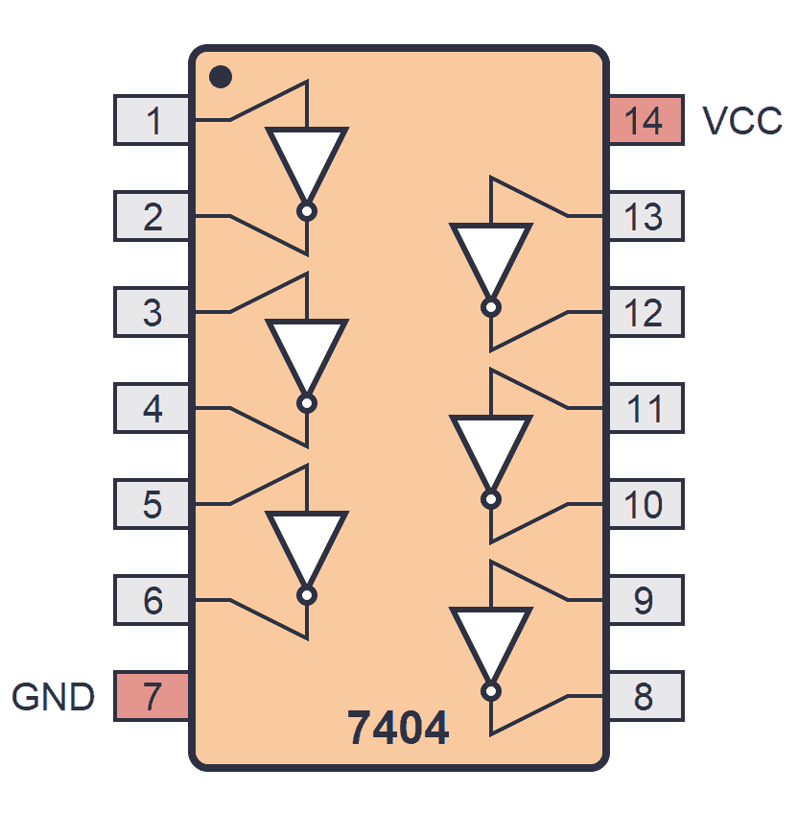
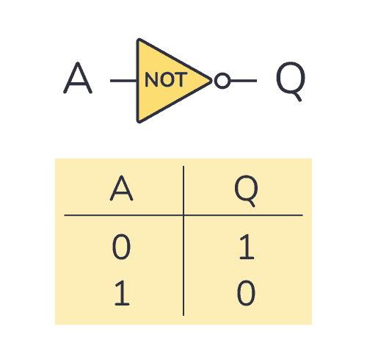
Hardware Components & Justification
NOT(7404)

Slide 6
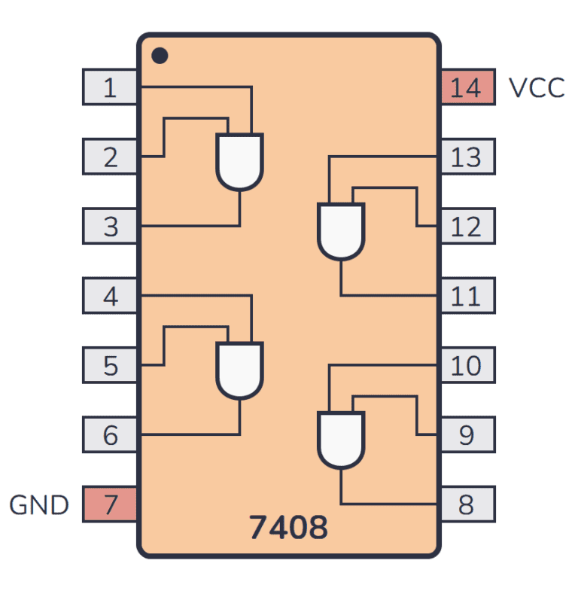
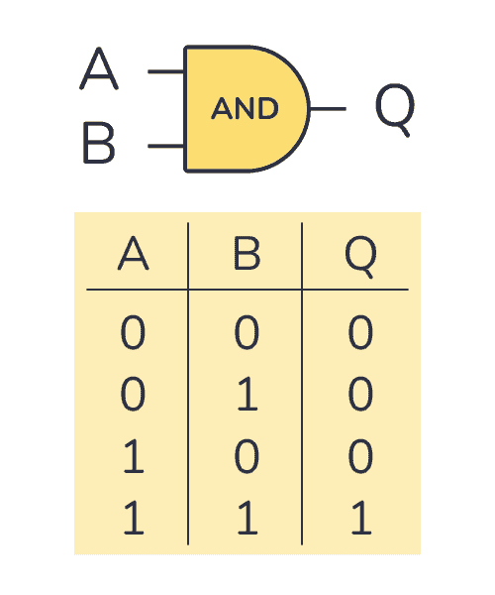
Hardware Components & Justification
AND(7408)

Slide 7
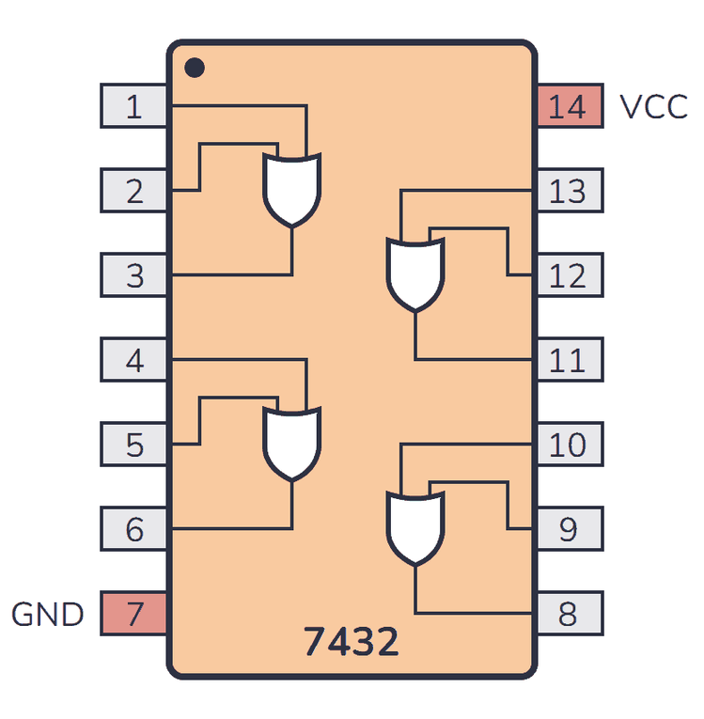
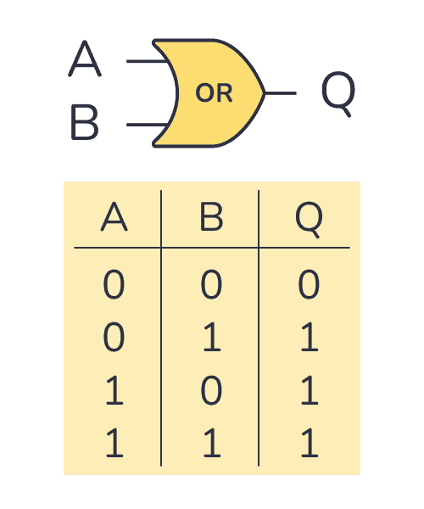
Hardware Components & Justification
OR(7432)

Slide 8
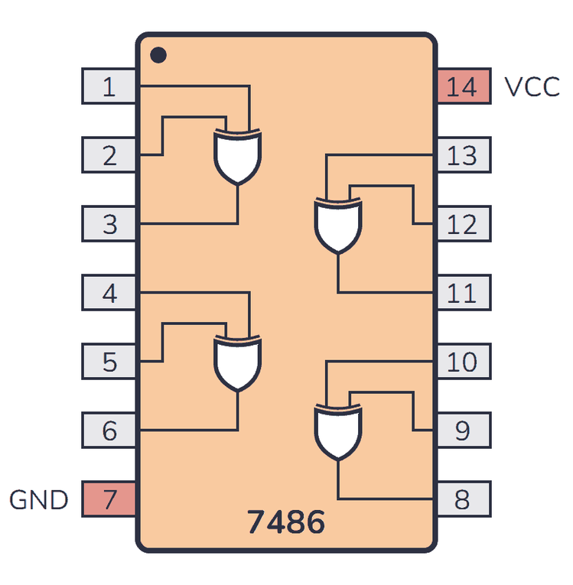
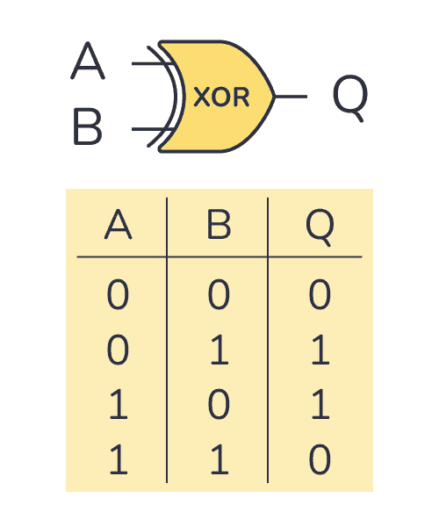
Hardware Components & Justification
XOR(7486)

Slide 9
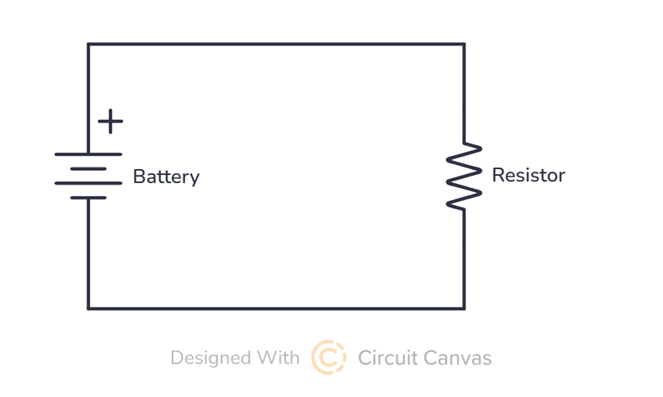
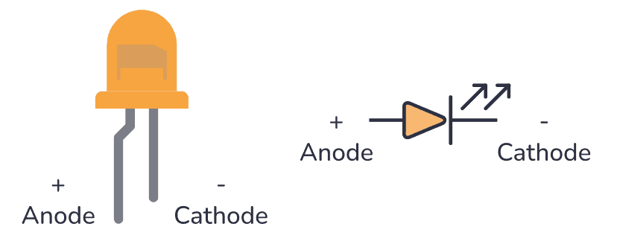
Hardware Components & Justification
LED & Resistor

Slide 10
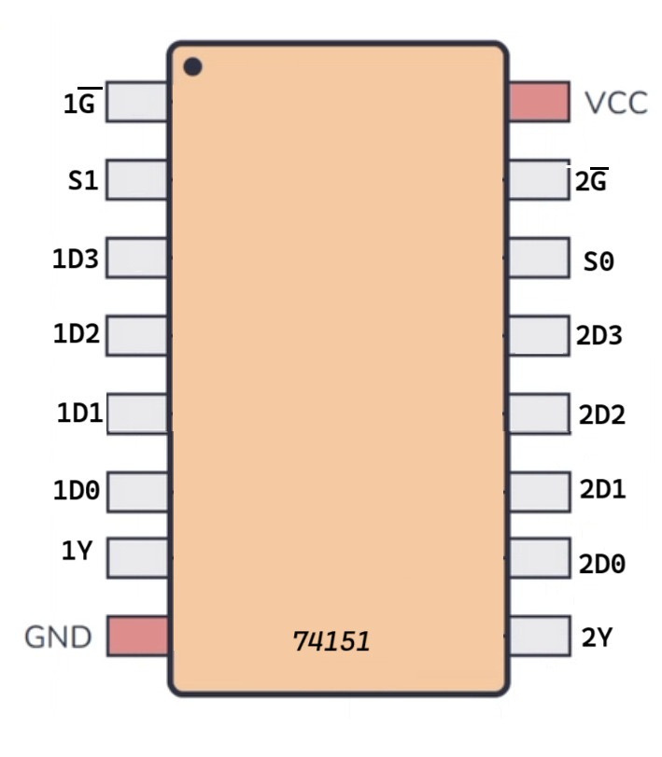
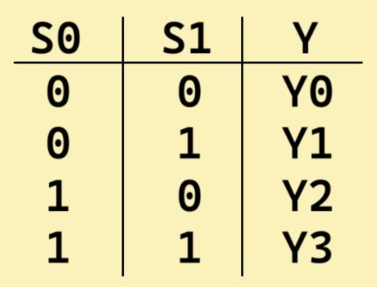
Hardware Components & Justification
4x1 Multiplexer(74151)

Slide 11
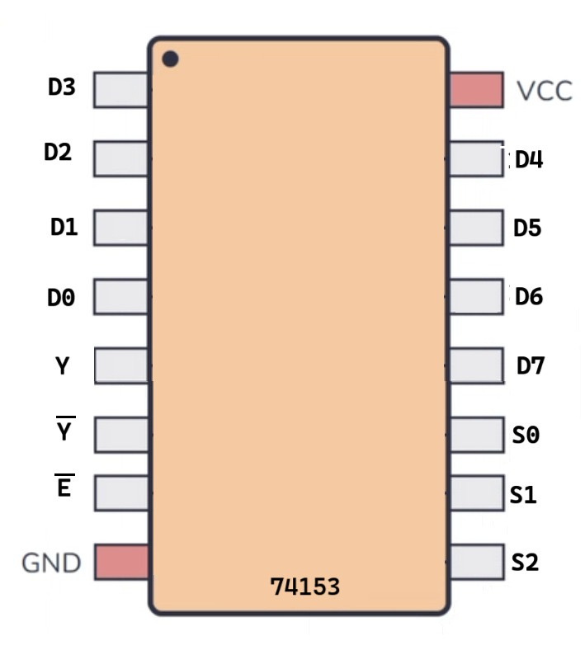
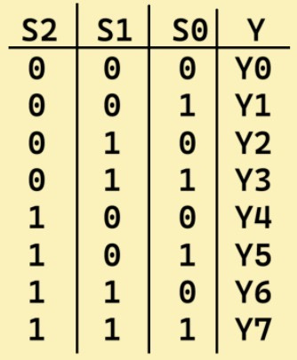
Hardware Components & Justification
8x1 Multiplexer(74153)

Slide 12
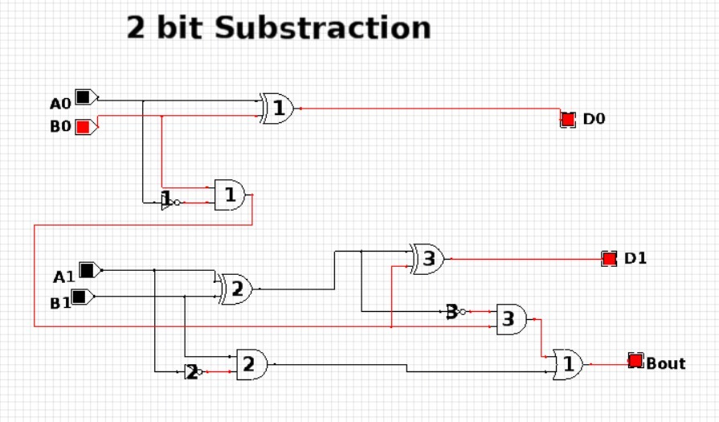
Circuit
1.Substraction

Slide 13
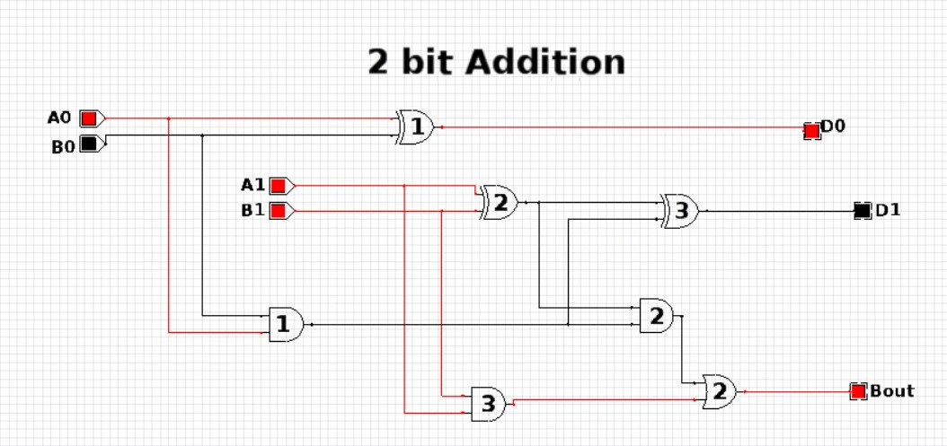
Circuit
2.Addition

Slide 14
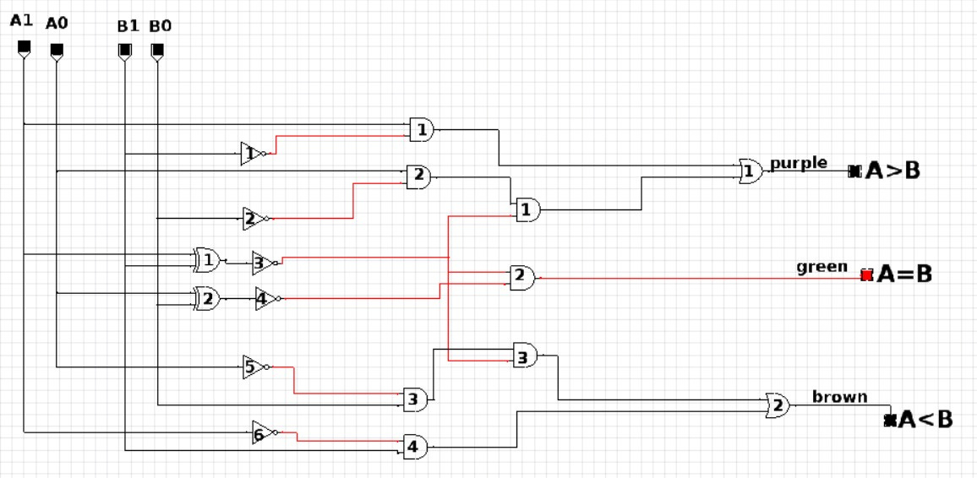
Circuit
3.Comparator

Slide 15
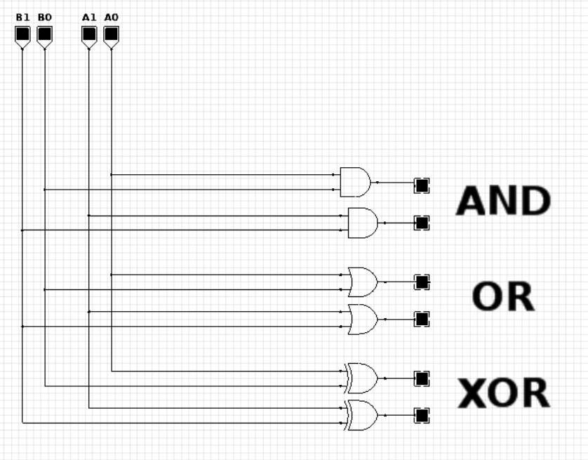
Circuit
4.Bitwise AND , XOR , OR

Slide 16
Future Scope
Expansion to 8-Bit or 16-Bit ALU
Addition of two more operation like Multiplication & Division
Introduction of Shift Operations (Bit Shifting)
Integration with Microcontroller or Processor (Arduino & ESP32)
Implementation on a PCB
Addition of Overflow and Underflow Detection

Slide 17
Learning Outcomes
Hands-On Digital Circuit Design
Understanding Basic ALU Operations
Working with Integrated Circuits
Troubleshooting and Problem-Solving
Logical and Analytical Thinking

Slide 18

Outro
THANK YOU !!

